Slide 1
PHOTO EDITING
RNS INSTITUTE OF TECHNOLOGY
BENGALURU - 98
DEPARTMENT OF COMPUTER SCIENCE & ENGINEERING
Presentation on Internship
ANUSHA - 1RN19CS017
NIRALI D BAFNA - 1RN19CS088

Slide 2
AGENDA
Abstract
About the Company
Introduction
Requirements
Detailed System Design
Implementation
Results
Conclusion and Future Enhancements
References
Q & A

Slide 3
ABSTRACT
As technology emerges day by day, digital images can be an indispensable source of receiving data. We encounter a lot of digital images in daily life. However, these pictures can be related to anything.
In the programming world, we can process digital images using various libraries or tools. Python provides many useful libraries such as OpenCV, Python Image Library (PIL), and Scikit-image.
Python Pillow module is built on top of PIL (Python Image Library). It is the essential module for image processing in Python. But it is not supported by Python 3. But, we can use this module with the Python 3.x versions as PIL. It supports the variability of images such as jpeg, png, bmp, gif, ppm, and tiff.

Slide 4
ABOUT THE COMPANY
NASTECH – New Age Solutions & Technologies
NASTECH is formed with the purpose of bridging the gap between Academia and Industry.
Nastech is one of the leading Global Certification and Training service providers for technical and management programs for educational institutions.
They collaborate with educational institutes to understand their requirements and form a strategy in consultation with all stakeholders to fulfill those by skilling , reskilling and upskilling the students and faculties on new age skills and technologies.
Industry and project oriented student training programs.
Certification programs mapped to Global Certification Exams from Microsoft/EC- Council/Google/AWS/ Adobe).

Slide 5
INTRODUCTION
Photo editing (also called post-processing) is the process, in digital photography, of making adjustments to photographs in a photo editing program.
Filter Lab provides an easy-to-use user interface which allows you to quickly edit images.
It allows the user to perform various operations such as color correction by using different color enhancement methods like contrast enhancing, contour, etc., Image flipping by flipping an image at horizontal or vertical axis, Image blurring, Image rotation etc.
In Filter Lab, we have used Pillow(PIL) module to format and filter images.
We have used Tkinter module for the front-end portion to display the updating photo and various widgets like buttons, scale, comboboxes etc.

Slide 6
REQUIREMENTS
HARDWARE REQUIREMENTS
Processor : Any Processor above 500 MHz
RAM : 512Mb
Hard Disk : 4 GB
Input device : Mouse
Output device : Resolution Monitor
SOFTWARE REQUIREMENTS
Operating system : Windows 10
IDLE : Python IDLE
Tools/Technologies : Python, Tkinter, PIL

Slide 7
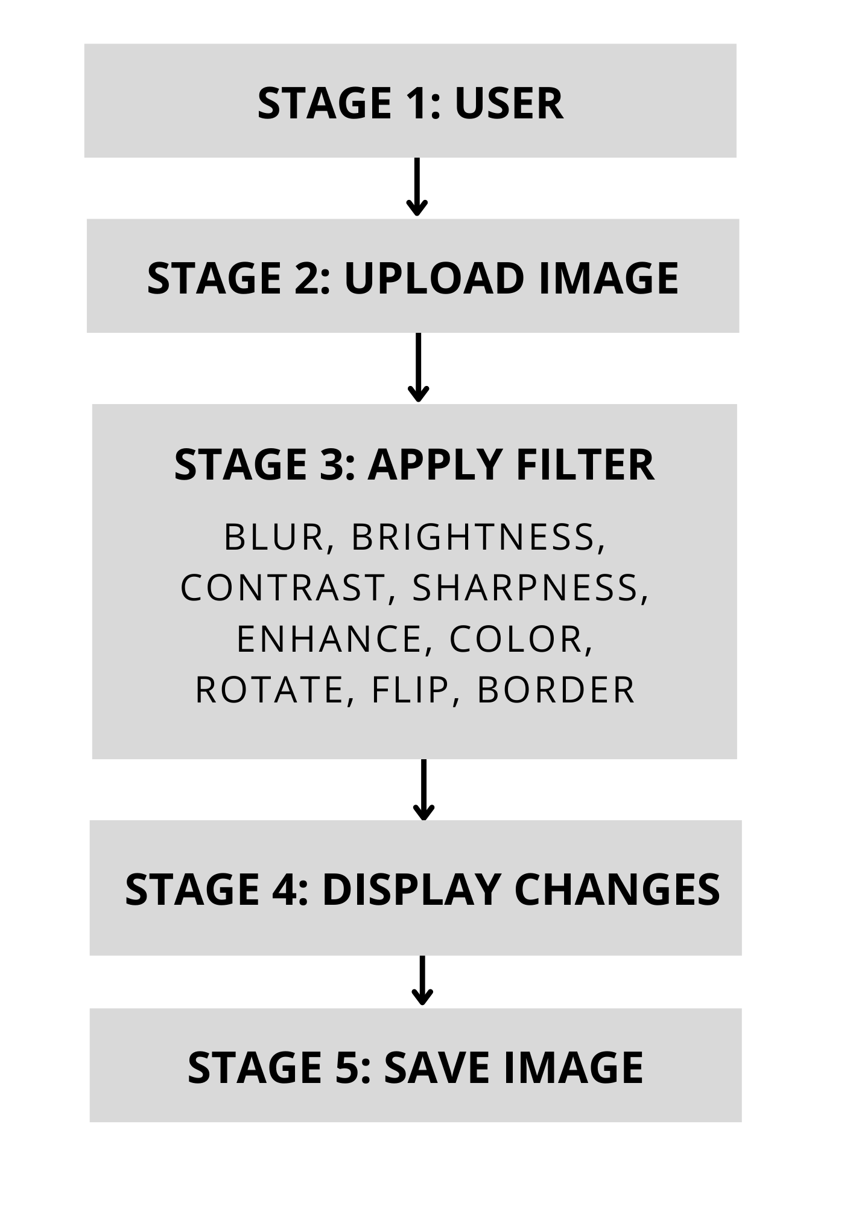
DETAILED SYSTEM DESIGN
This software system first allows the user to choose an image from your local computer and upload it onto the canvas. On clicking button ‘Select Image’ directs the user to a dialog box through which the image can be selected.
The selected image is placed on to the canvas on which various transformations can be applied.
It allows the users to rotate or flip the image.
The user may adjust the brightness, sharpness, contrast of an image.
It is also possible to apply blur effect, enhance the image, increase color intensity of an image.
The user also has an option to add border to the image.
The filtered images are displayed on the canvas and thus the user can save the images on to their local computers.

Slide 8
IMPLEMENTATION
CREATING CANVAS
CREATING WINDOW
root = Tk()
root['bg']='black'
root.title("FILTER LAB")
root.geometry("1080x620")
root.resizable(width = False, height = False)
canvas2 = Canvas(root, width="420", height="420", relief=RIDGE, bd=7, highlightbackground="#696969", highlightthickness=7)
canvas2.place(x=120, y=50)
CREATING BUTTON
def on_enter(e):
btn1.config(background='white', foreground= "black")
def on_leave(e):
btn1.config(background= '#106dc9', foreground= 'white')
btn1 = Button(root, text="Select Image", bg='#106dc9', fg='white',width=12, font=('consolas 12 bold'), relief=SUNKEN, command=selected)
btn1.place(x=120, y=540)
btn1.bind('<Enter>', on_enter)
btn1.bind('<Leave>', on_leave)

Slide 9
IMPLEMENTATION
CREATING LABELS, SCALES AND COMBOBOXES
blurr = Label(root, text="Blur:", font=("consolas 17 "),fg='white', bg='black', width=7, anchor='e')
blurr.place(x=700, y=205)
v1 = IntVar()
scale1 = ttk.Scale(root, from_=0, to=10, variable=v1, orient=HORIZONTAL, command=blur)
scale1.place(x=800, y=211)
rotate = Label(root, text="Rotate:", font=("consolas 17 "),fg='white', bg='black', width=7, anchor='e')
rotate.place(x=700, y=50)
values = [0, 90, 180, 270]
rotate_combo = ttk.Combobox(root, values=values, font=('consolas 10 '))
rotate_combo.place(x=800, y=57)
rotate_combo.bind("<<ComboboxSelected>>", rotate_image)

Slide 10
IMPLEMENTATION
FUNCTIONS
SELECTING AN IMAGE
def brightness(event):
global img_path, img2, img3
for m in range(0, v2.get()+1):
img = Image.open(img_path)
img.thumbnail((350, 350))
imgg = ImageEnhance.Brightness(img)
img2 = imgg.enhance(m)
img3 = ImageTk.PhotoImage(img2)
canvas2.create_image(225, 225, image=img3)
canvas2.image=img3
img_path = filedialog.askopenfilename(initialdir=os.getcwd())
img = Image.open(img_path)
SAVING AN IMAGE
ext = img_path.split(".")[-1]
file=asksaveasfilename(defaultextension =f".{ext}",filetypes=[("All Files","."),("PNG file",".png"),("jpg file",".jpg")])
if file:
if canvas2.image==img1:
imgg.save(file)

Slide 11
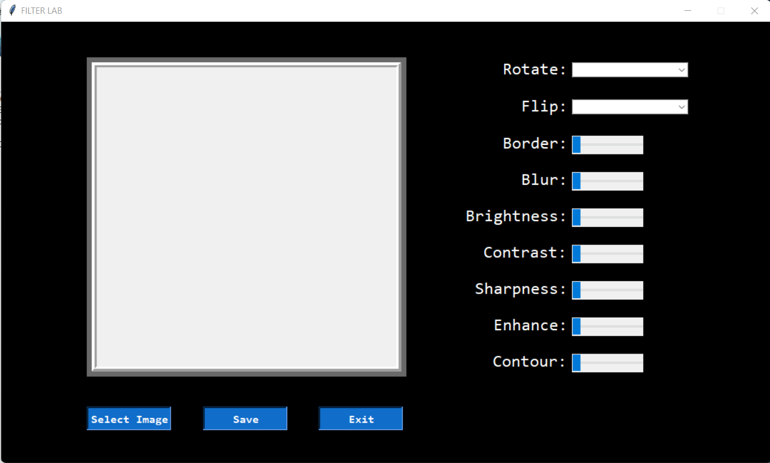
RESULTS

Slide 12
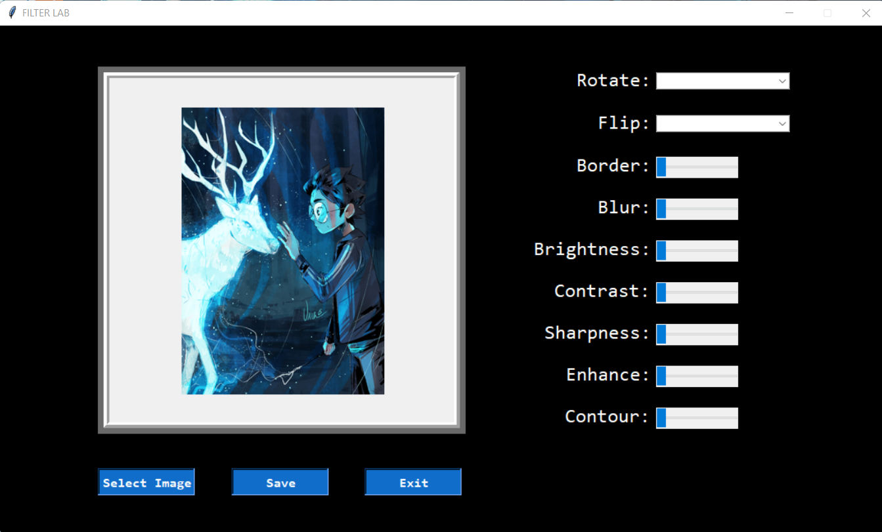
RESULTS

Slide 13
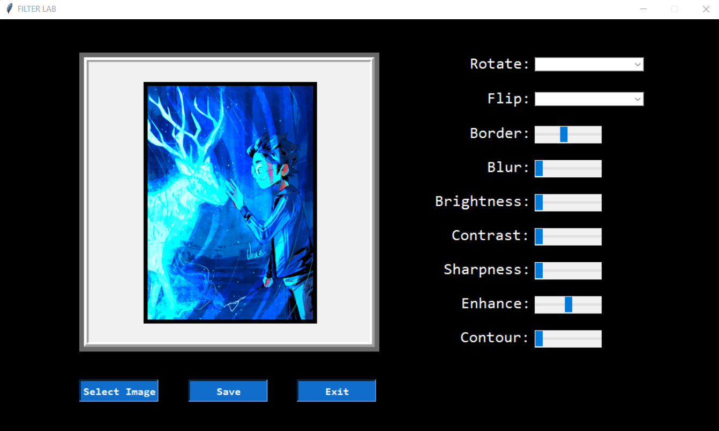
RESULTS

Slide 14
CONCLUSIONS
With photo editing software, we can reveal the true potential of photos. It allows us to manipulate pictures, bringing colors to life, making focus much sharper.
We can easily lighten darker photos by changing the brightness level.
We can produce artistic effects on an image using various filters.
We can create a point of focus that draws the eye in using ‘blur’ effect.
So all we need is a digital camera, a computer and a photo editing software.

Slide 15
LIMITATIONS
The user can apply only one filter at a time.

Slide 16
FUTURE ENHANCEMENTS
To circumvent aforementioned issue, we can allow the users to apply multiple filters on the same image.
We can also implement cropping of an image, doodling on an image, and an undo operation.

Slide 17
REFERENCES
https://www.geeksforgeeks.org/python-pillow-a-fork-of-pil/
https://www.python.org/doc/
https://www.geeksforgeeks.org/python-gui-tkinter/
https://www.javatpoint.com/python-pillow
http://iosrjen.org/Papers/NSER'2012/A0280103.pdf
http://www.gov.pe.ca/photos/original/4h_photoed.pdf

Slide 18
THANK YOU

Slide 19
Question and Answer

